Slide 1


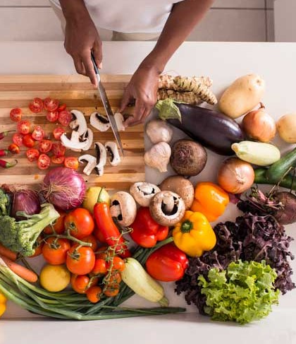

Promoting Heathy Eating and Balanced Diet
By Redefine-Me
Sprint 6
Professor: Henry Wong
Computer Science Project
Course : CS692
Team: 2 (Tiny Coders)
Designed by : Maanasa Dharini.

Slide 2
AGENDA
Team Members Roles and Responsibilities
Improvements from professor feedback
Project Description
Teamwork Agreement
Personas
Minimal Viable Product (MVP)
Technologies
Algorithm
Diagrams
Sprint 4 Recap
Product Backlog
Sprint 5 Backlog
Metrics
Retrospective
Sprint 6
Project Demo
Git-hub Link
Live Application Demo

Slide 3

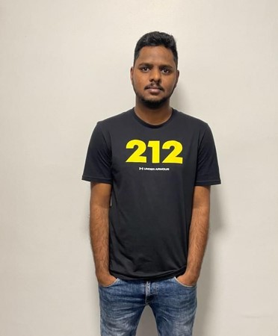
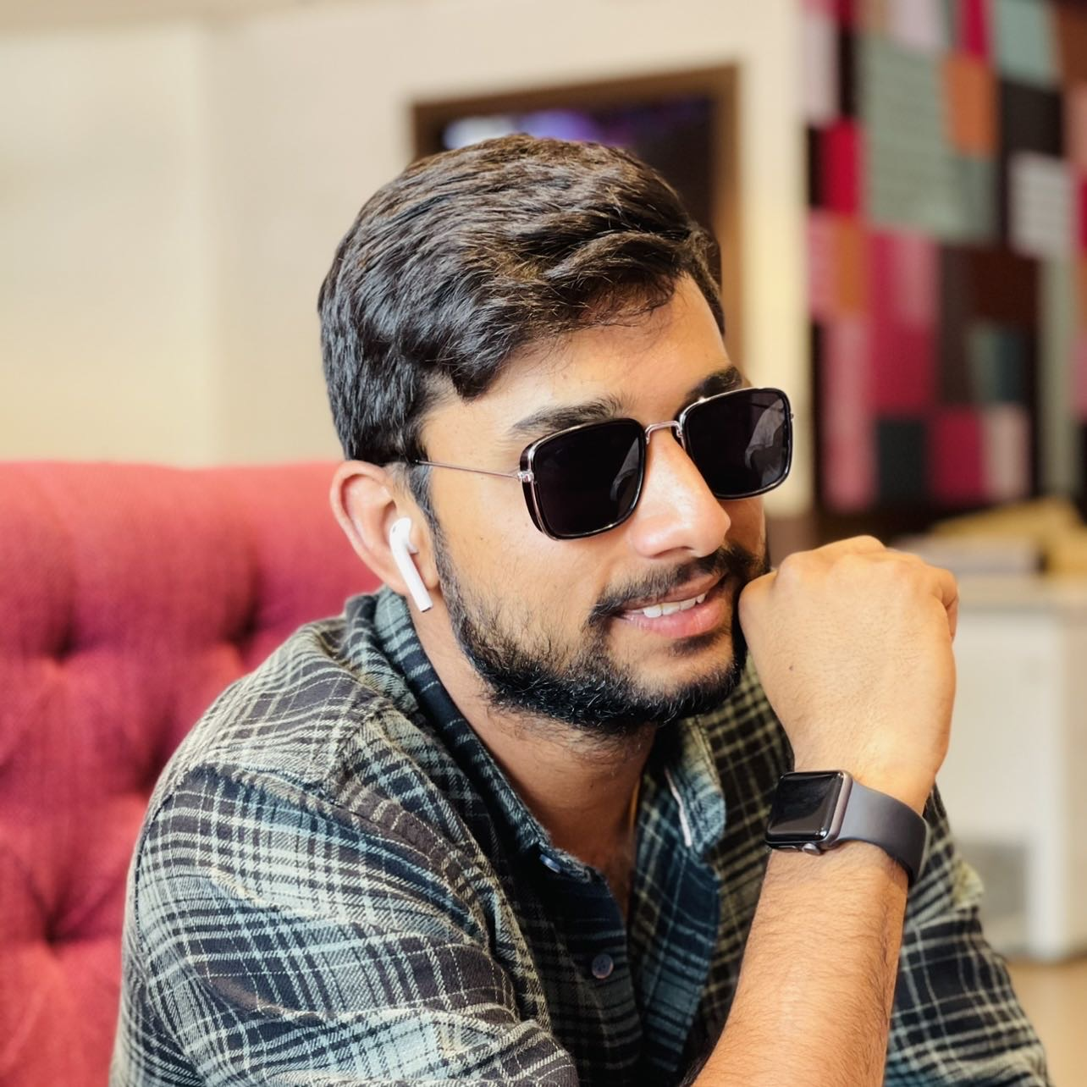


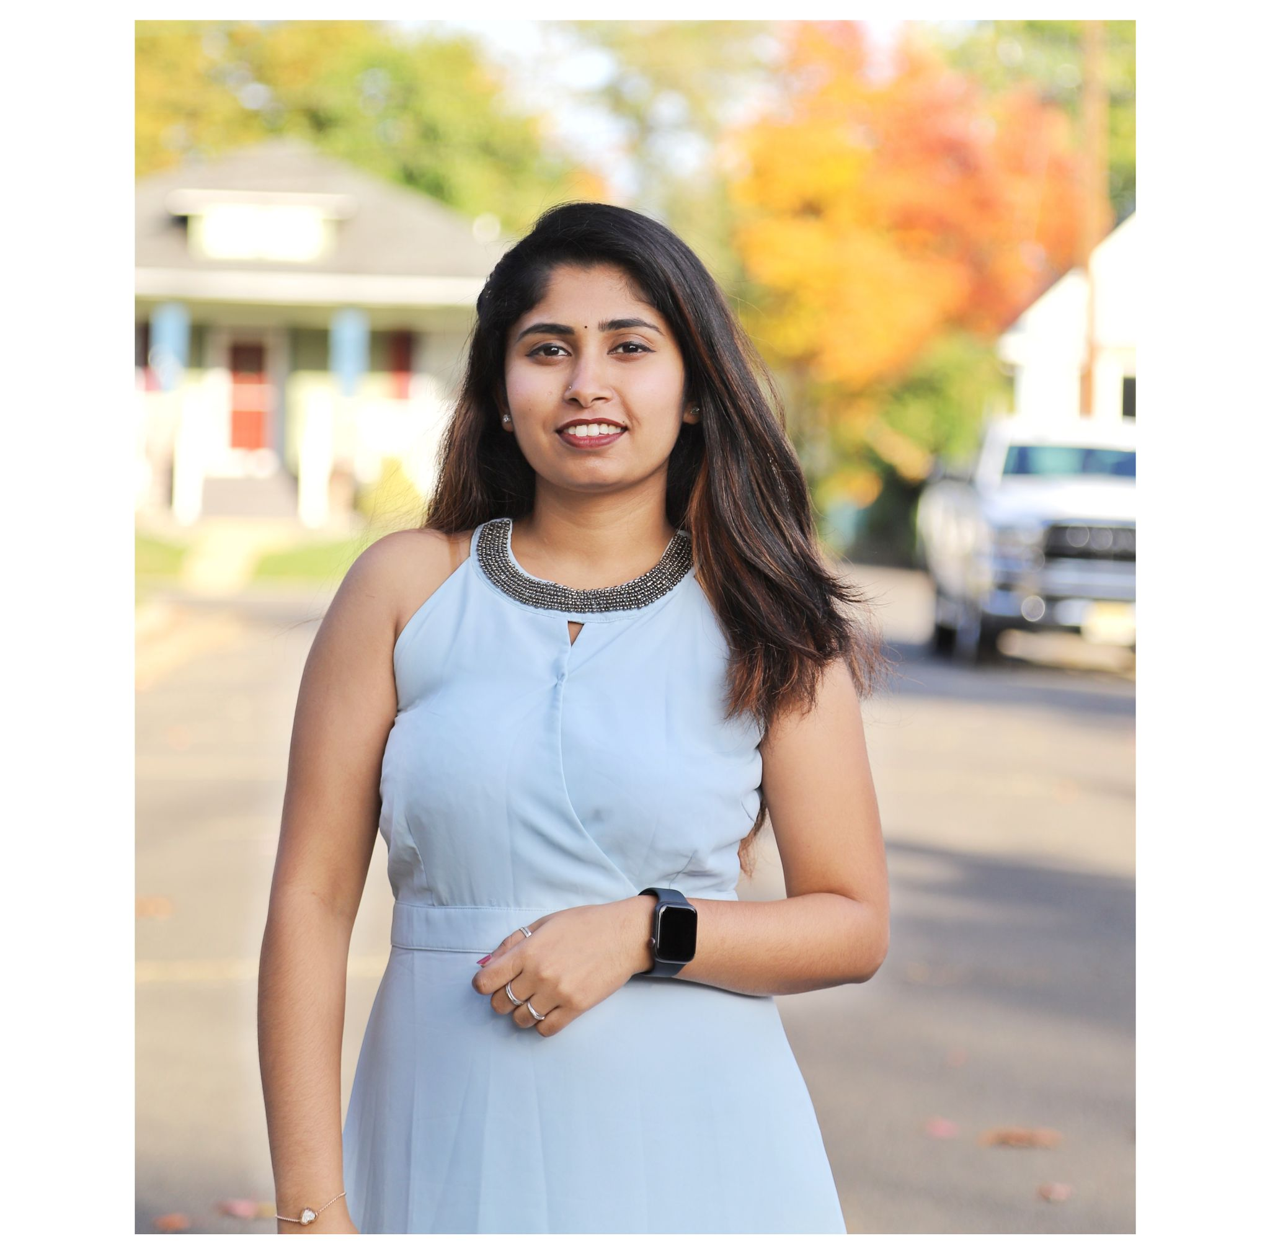
Team Member Roles
SATHWIK MUDENTI
DEVELOPER 1
VARUN REDDY
DEVELOPER 2
DHARINI MAANASA
DEVELOPER 3
NARESH BABU CHINTA
QA/TESTER
BRUNDA REDDY
DBA

Slide 4


Improvements made from Professor Feedback
Professor feedback
Improvements Made
New Templet is needed.
Proper Project Description is needed.
Make changes in Architecture diagram.
Update ER Diagram.
Add story points to sprint 5and 6 backlog and specify the issue/task.
Add tech paper and deployment manual.
Add algorithm network architecture.
Change the format in which we write our test cases and output.
Add story points to Metrics.
Worked on new templet.
Updated the project description.
We made changes to architecture diagram.
Er Diagram is updated.
Added new story points and specified issues and tasks.
Completed the Tech Paper and Deployment Manual.
Algorithm Network Architecture is added.
We changed the format of our test cases.
We updated metrics.

Slide 5
Project description
Project Description
Project Name: | Promoting Healthy Eating and Balanced Diet with Re-Define Me.
Team Name: | Tiny Coders
Project Description: | We are providing the customers a healthy living habits with proper nutrients and workouts with unique features according to the user customization. For Customers: Who wanted to take proper medications, supplements ,diet and workouts our web application ”Re-Define Me”
Benefit Outcomes: | Customers can contact dietitian and personal trainers ones the user subscribes to the application The dietitian provides the nutrients details and the supplements to the customer without going to the hospital directly. It will provide the details of the gyms nearby and highly rated personal trainers.
GitHub Wiki: | https://github.com/DhariniMansi/CS691.wiki.git

Slide 6
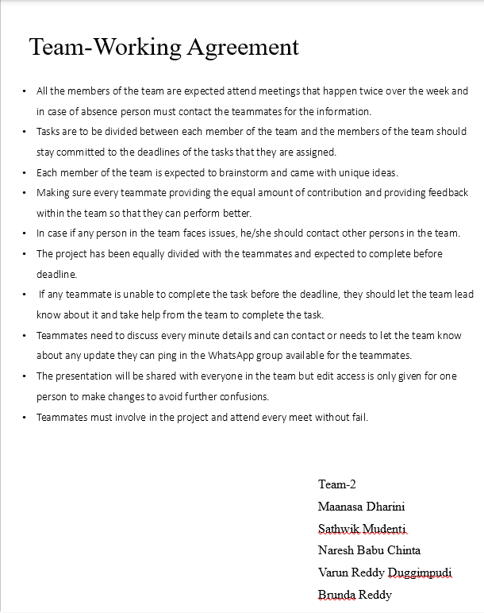
Team Working Agreement

Slide 7
PERSONAS

Slide 8
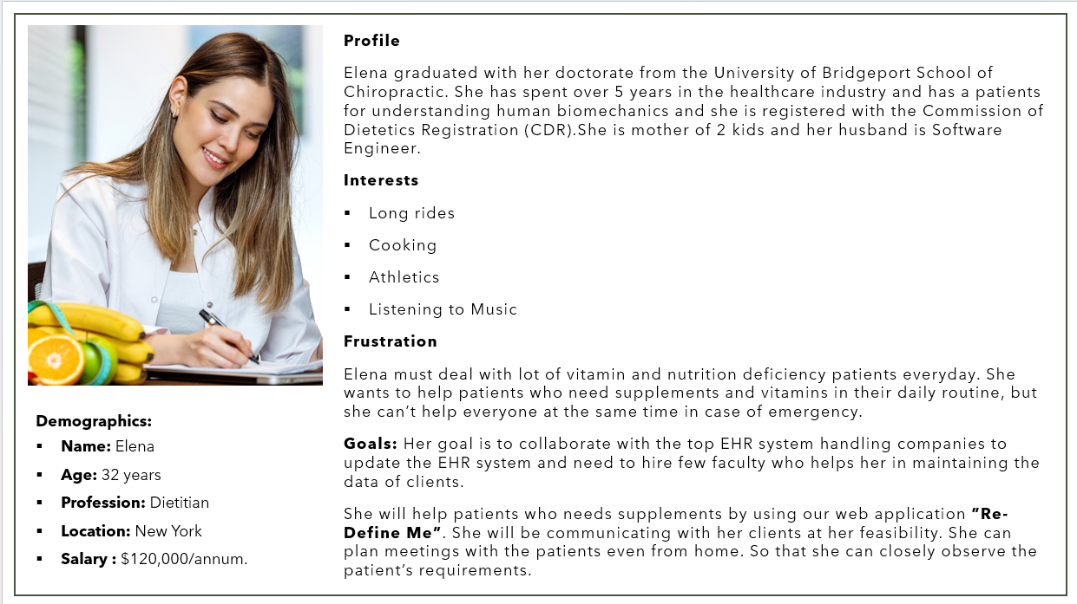

Slide 9
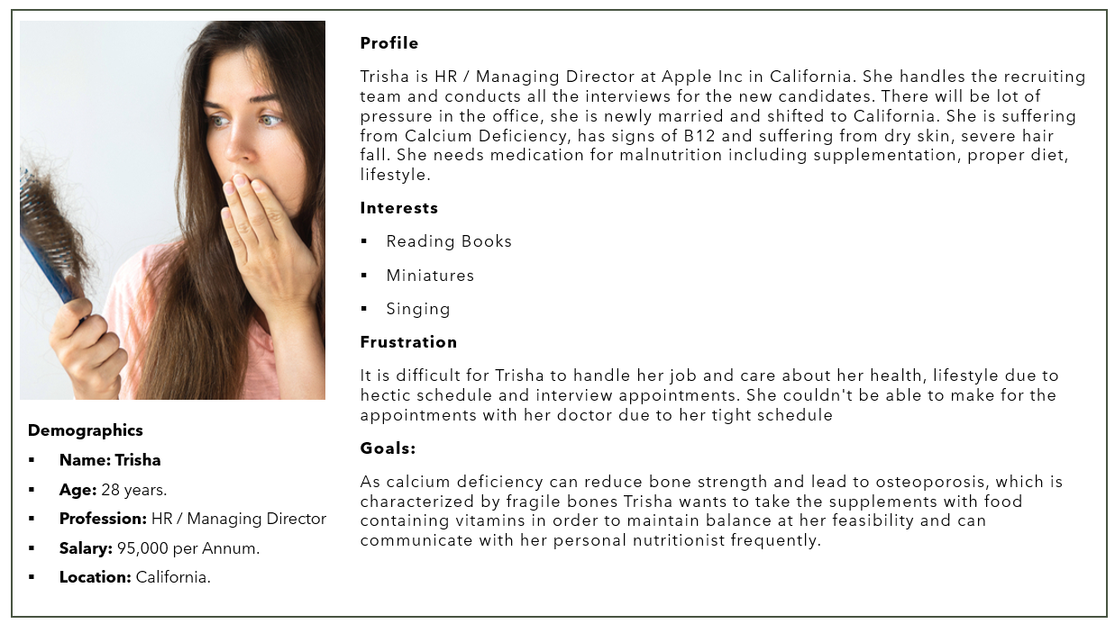

Slide 10
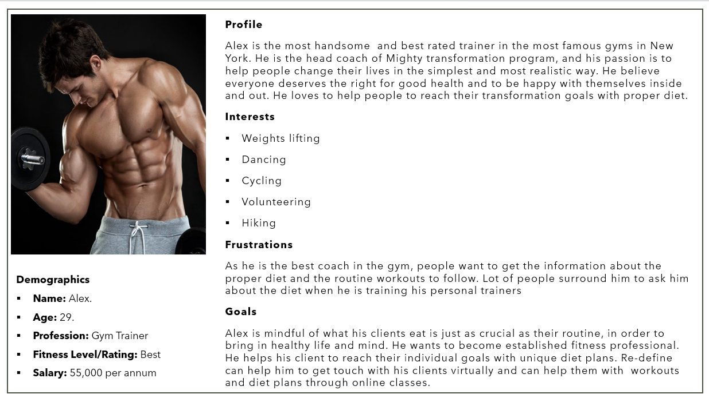

Slide 11
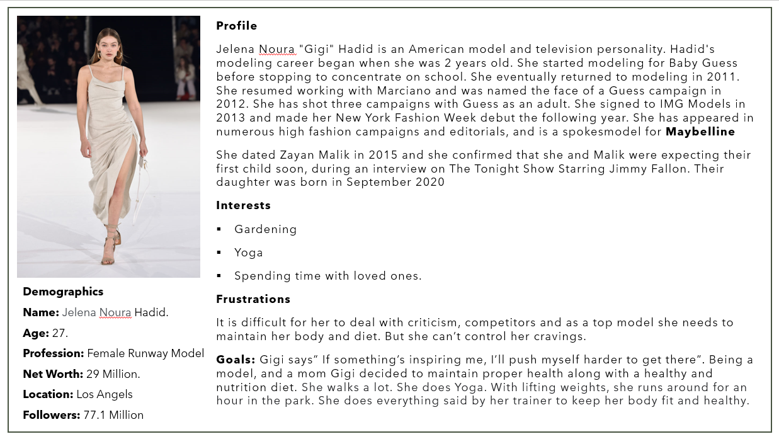

Slide 12
MVP
Home Page
Sign In
Log In
Calorie Calculator
Calorie Estimation
Food & Diet Plan
Recipes
Preparation time
Ingredients
Calorie Estimation
Preparation Time
Generate Recipe
About
Contact
Sign Out

Slide 13
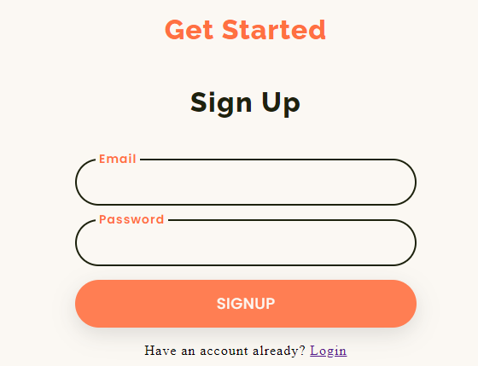
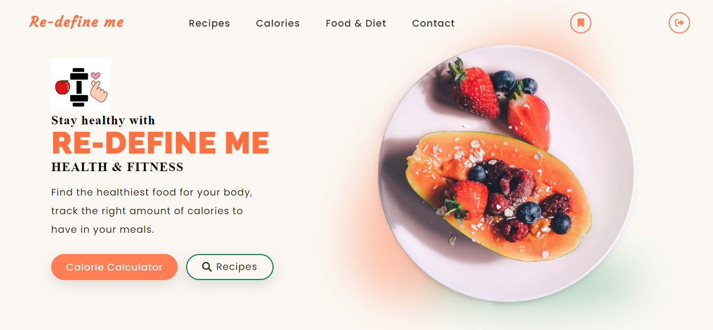
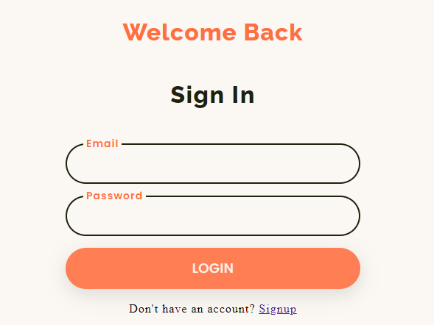

Slide 14
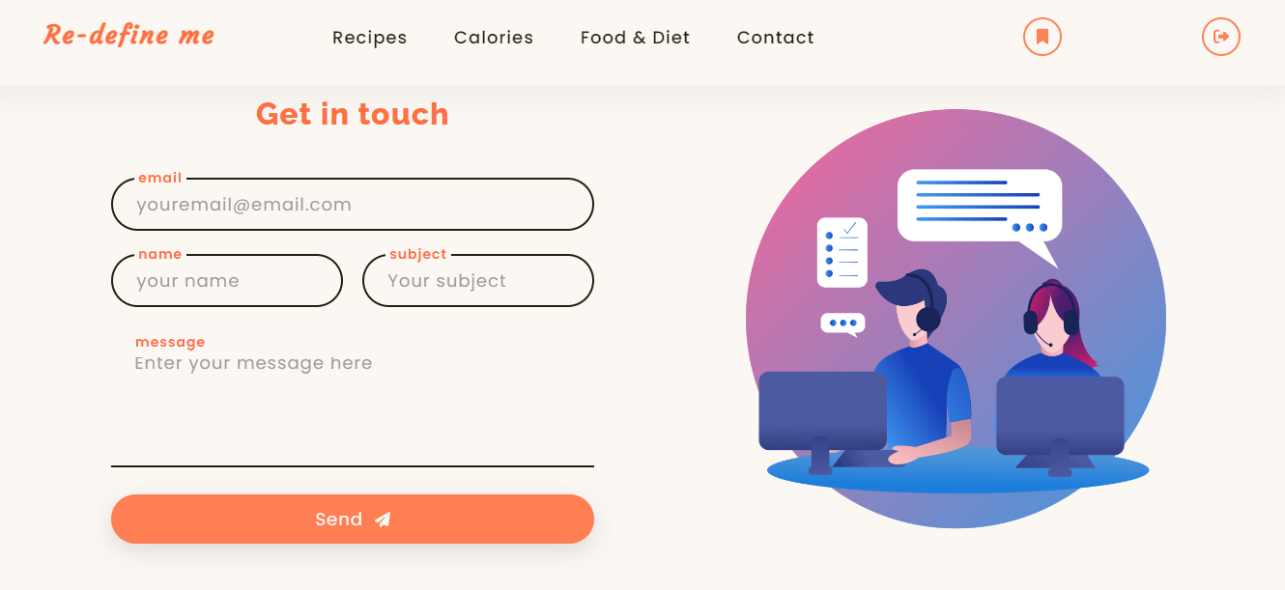
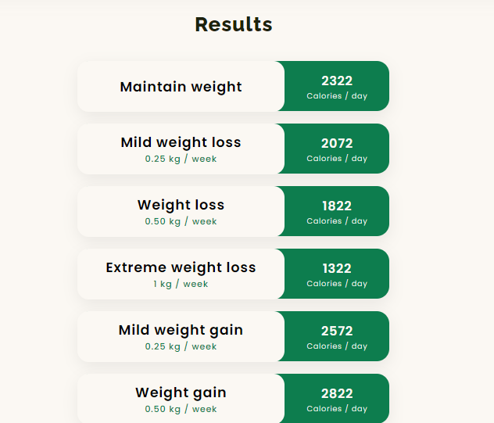
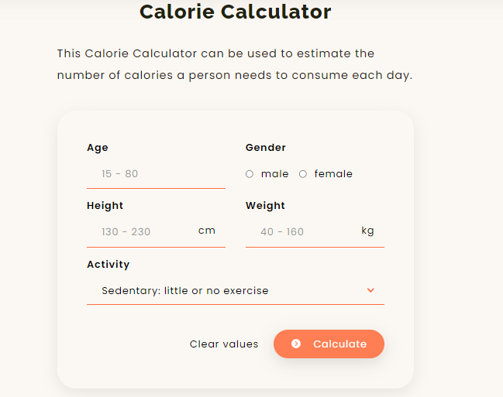
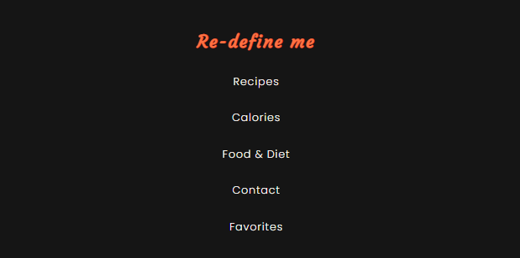

Slide 15
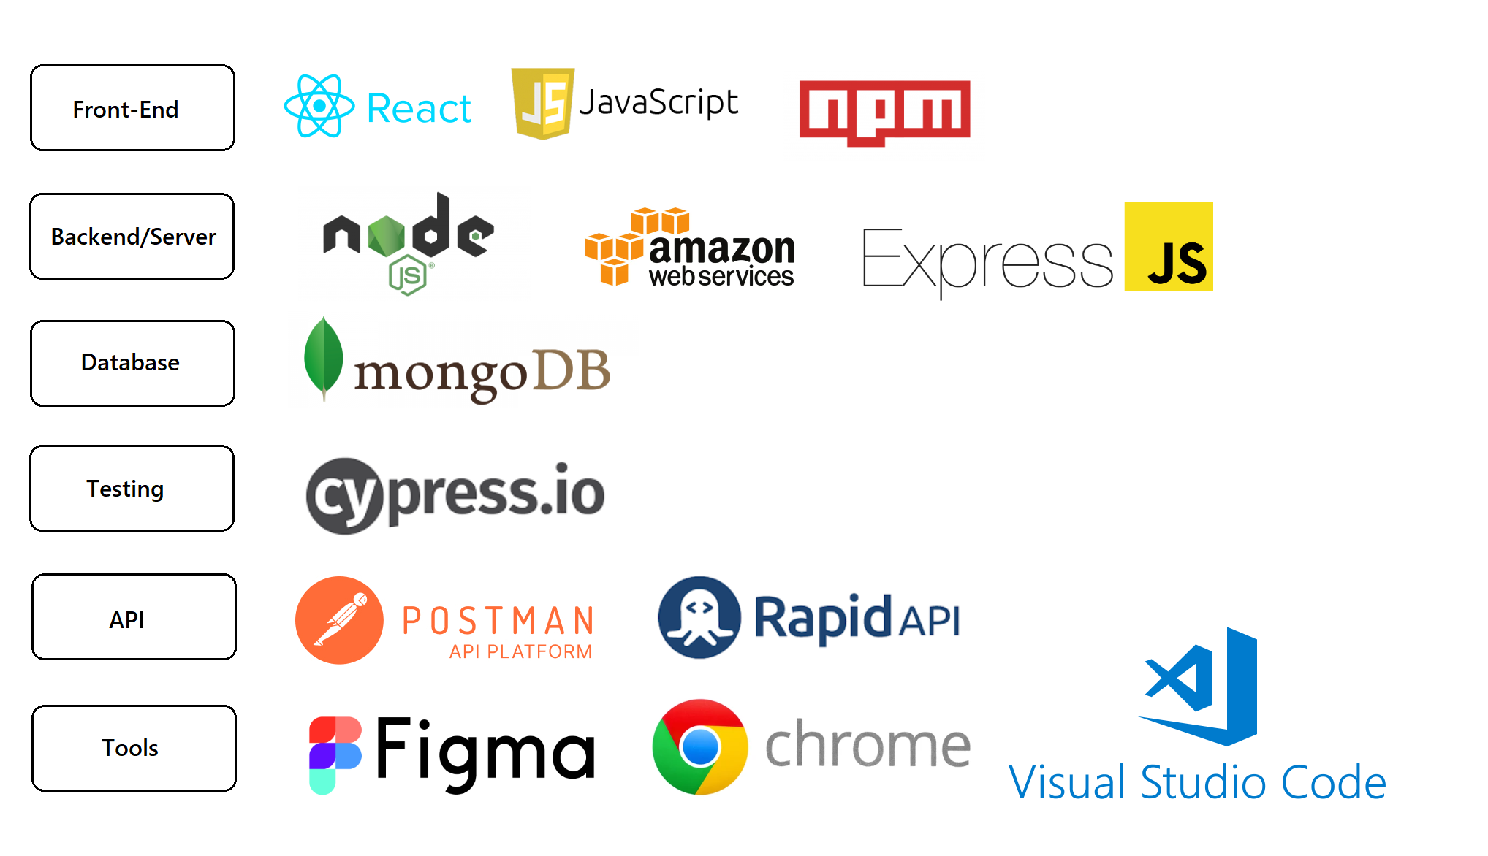
Technologies

Slide 16

Diagrams

Slide 17
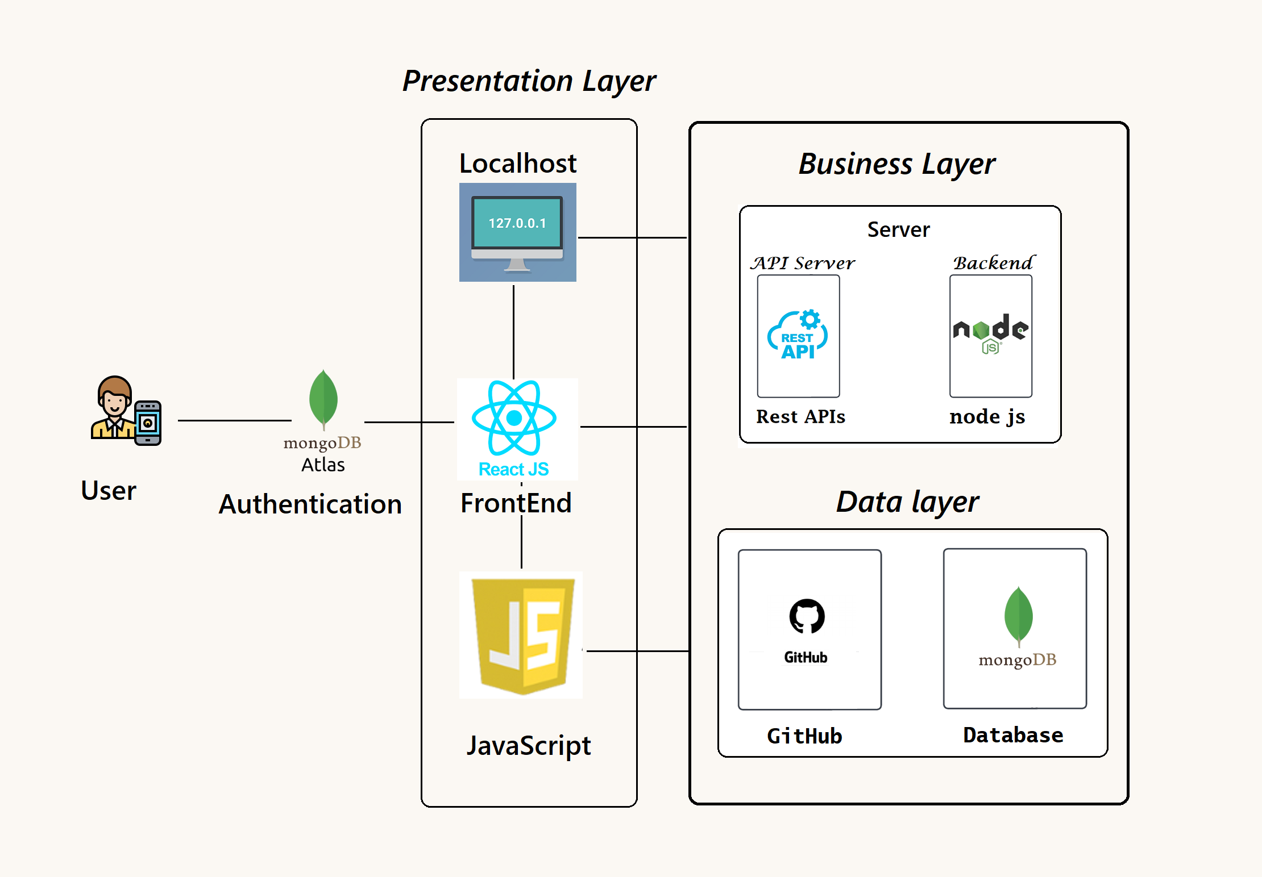
Architectural Diagram

Slide 18
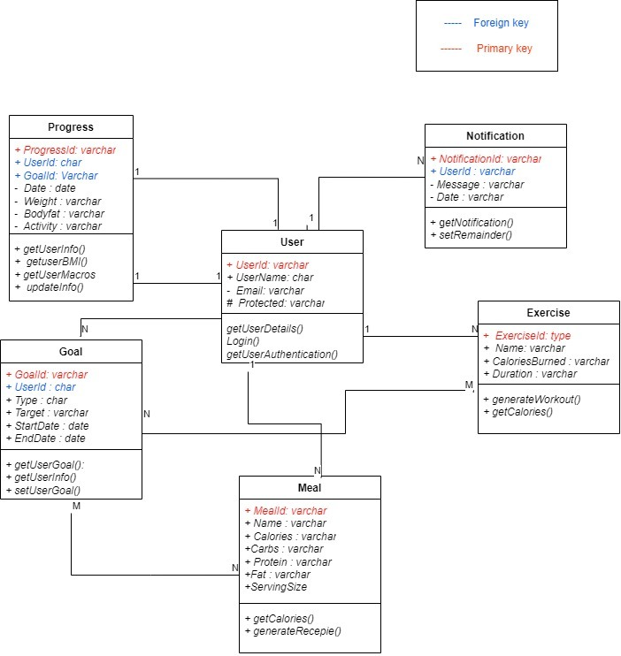
ER Diagram

Slide 19
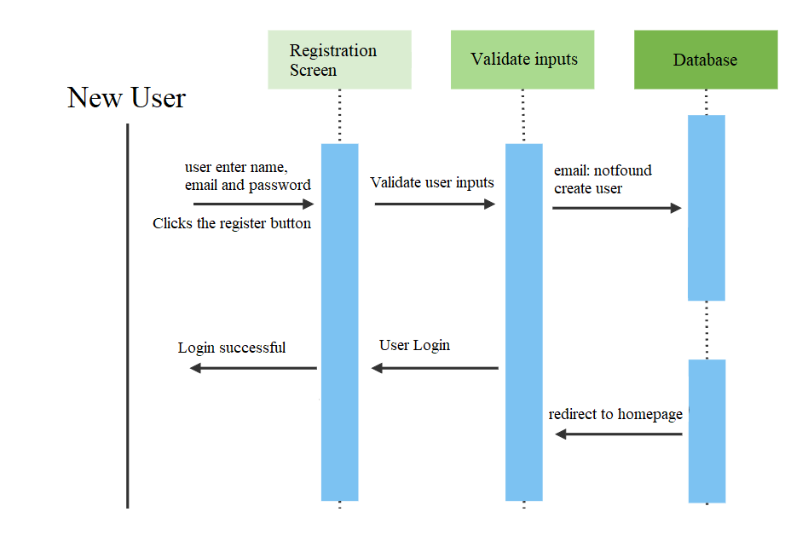
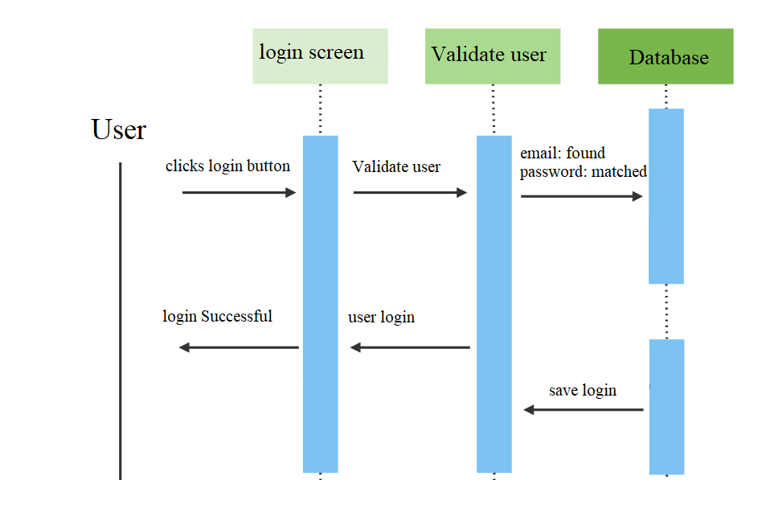
User sequence diagrams

Slide 20
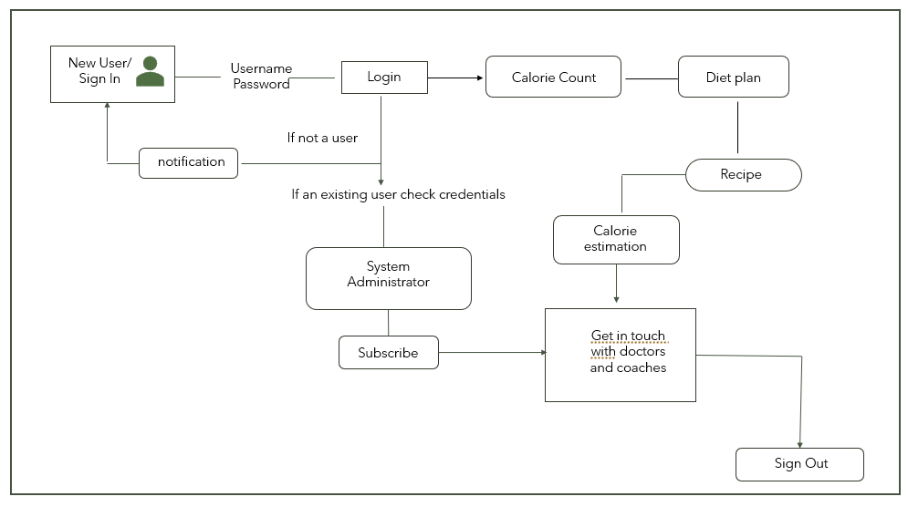
Data Flow Diagram

Slide 21
Algorithm
Calorie counting is a process where it uses multiple algorithm such as object detection and is linked to a database where the calorie information of each food and ingredients is stored in it. When a user take pictures of their meal, it will detect the food and automatically count the total calories that is about to be consumed for the users. This is applied in many healthy diet applications to help users to keep track of the numbers of calories consumed in the food so that one will not eat too much.
Since healthy diet is popularly concerned in this modern world. These application able to help the individuals to maintain and improve their overall health by providing relevance information such as calories, nutritional facts as well as keeping track of their food intake. One biggest flaws that these applications have made are that they do not have object counting algorithm. This will affect the counting process and will not be able to provide an accurate result during the process. The information are too generalized where the calories are counted in a fixed portion or the user have to manually select their quantities of it, but most of them would not prefer to gone through these hassle. The aim for this project is to further enhance these applications in the form of accuracy in counting food calories by using object detection and object counting so that each of every ingredients and food to be consumed by the user is determined and provide a precise result for them.

Slide 22
Sprint 5 recap
Completed the Tech paper.
Created a Sign/Login Page.
Added features for the Application
Worked on new user stories
Design backend & working on Database.

Slide 23


Sprint 5 Vs Sprint 6
Sprint
Sprint
Added new story points and specified issues and tasks.
Recipes and recommendation are added according based on maintenance calories.
Worked the Tech Paper and Deployment Manual.
Adding the coaches and doctors' lists.
Working on Tech Paper
Created a Sign/Login Page
Adding New Features to the application
Design backend & working on Database.

Slide 24
Product Backlog

Slide 25
Sprint 5 Backlog

Slide 26
User Stories and Acceptance Criteria

Slide 27
Test Cases

Slide 28
Test Cases

Slide 29
Stories \ Task Completed and Not Completed

Slide 30


Metrics

Slide 31

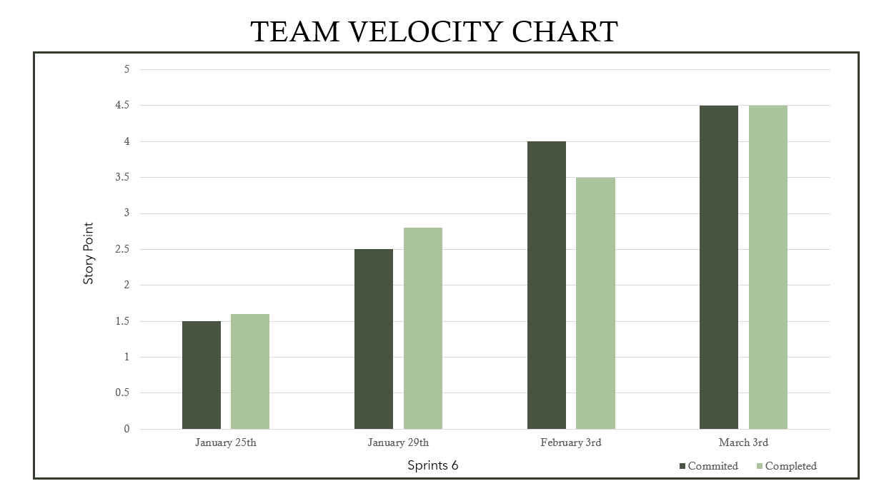

Slide 32
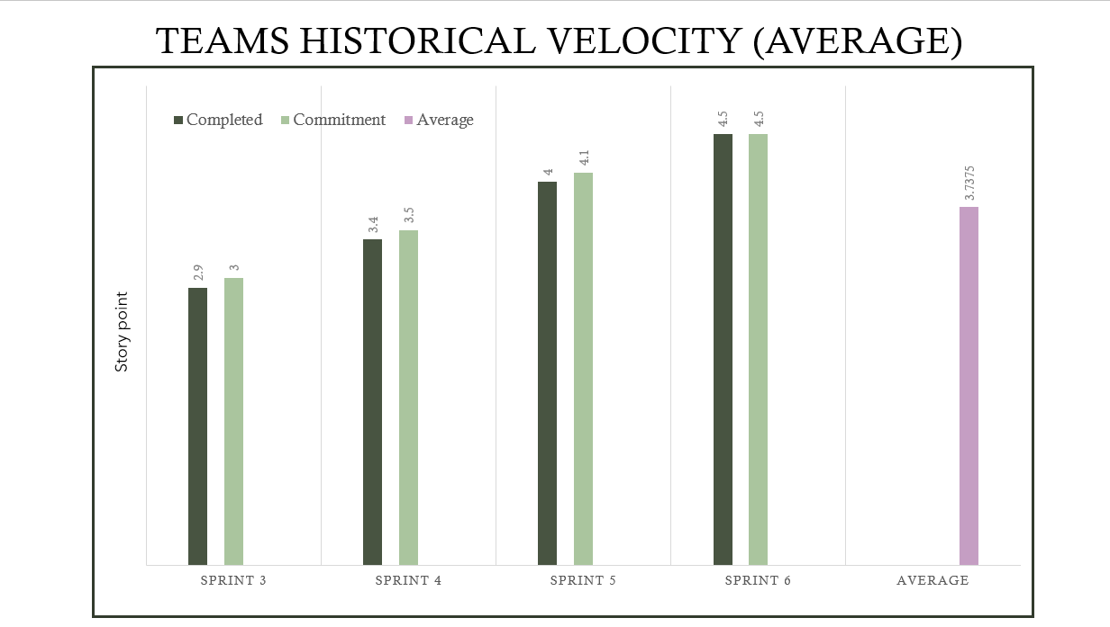

Slide 33
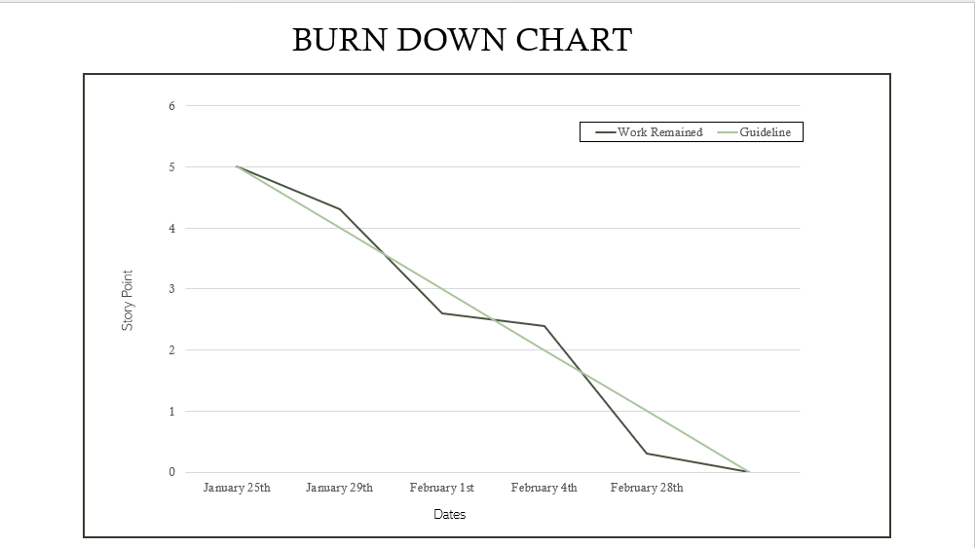

Slide 34
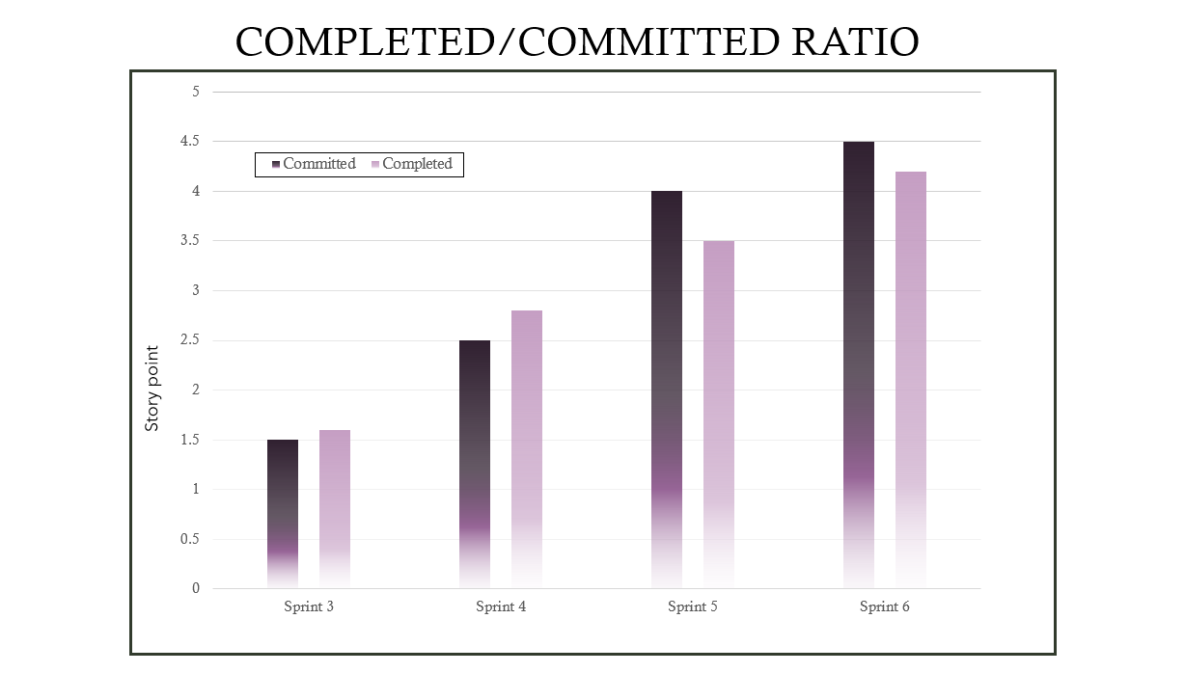

Slide 35

Retrospective

Slide 36






What went well?
Most of the meetings went according to the scheduled manner and the team members complemented each other well.
The collaboration was great in our paired sessions
Priorities were clear and members took them into account.
Tasks were clearly defined and assigned on the first day of starting the sprints
We completed the sprint 6 deliverables on time
Teammates supported and helped each other to submit deliverables on time

Slide 37


What needs improvement?
Require more time to work on the new features that are added.
Couldn’t be able to conduct required meetings as the teammate were busy with their own schedules
Avoid delaying the work and depending on the other teammates to complete their tasks.

Slide 38


Next steps
Need to improve time-management and spend more time to work on the deliverable.
Attend all the meets, provided in the WhatsApp group to share the work for the sprint and discuss any new updates about the project.
Each members need to take initiative and work on their part for sprint submission.
Team should focus on timely integration and deployment.

Slide 39
Stories planned and committed for Sprint 7

Slide 40

Project Demo

Slide 41
Slides App Screenshot

Slide 42
Slides App Screenshot

Slide 43
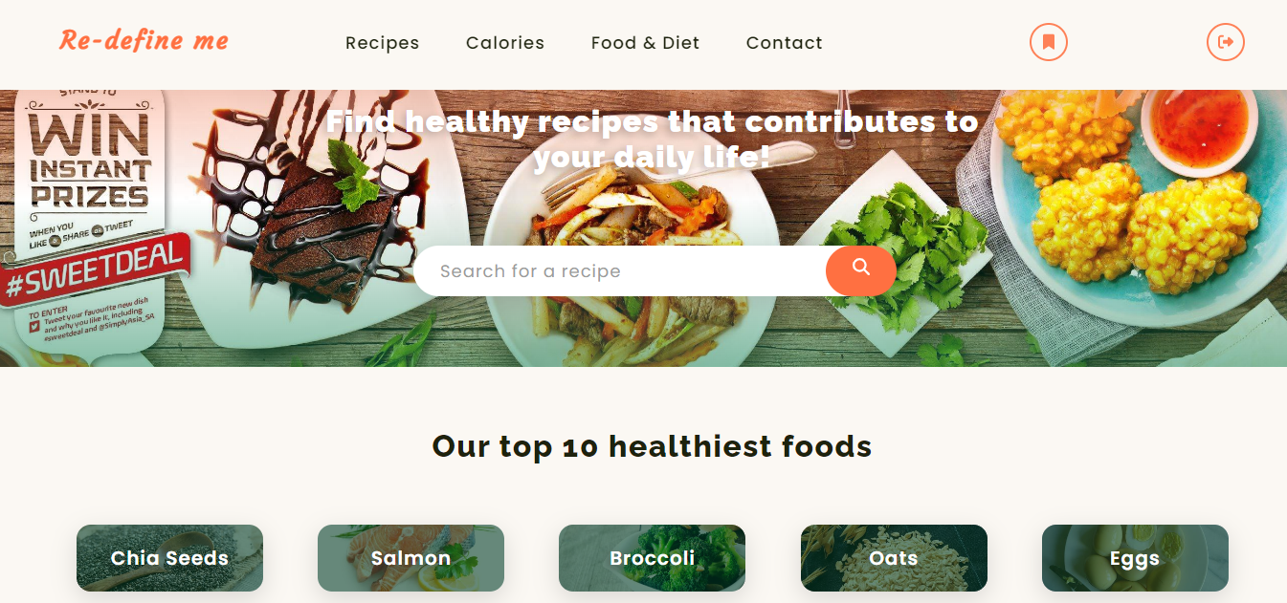
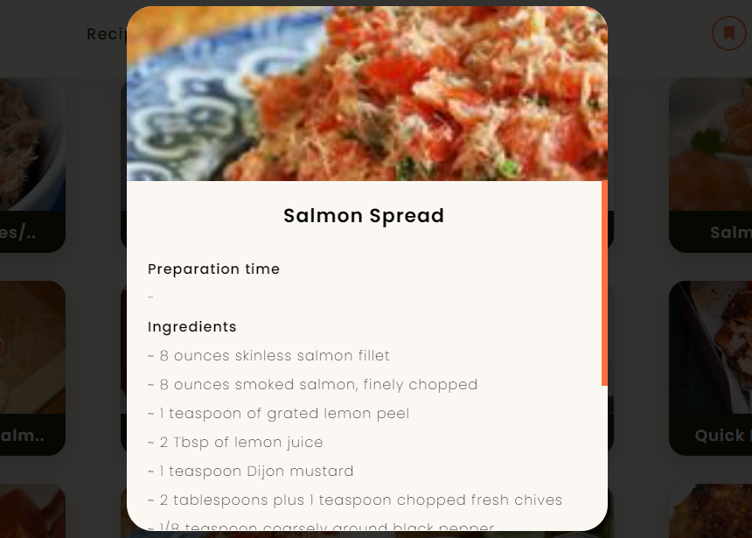
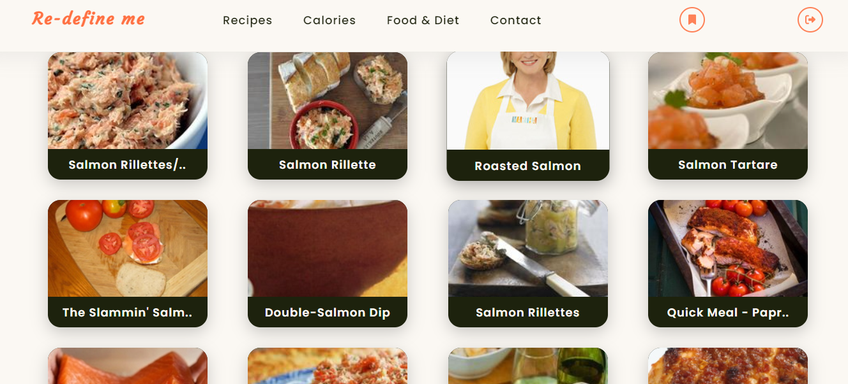
Slides App Screenshot

Slide 44
Slides App Screenshot

Slide 45
GitHub Link
Technical Paper Link
Installation Manual Link
API Documentation

Slide 46

Happy Eating
Tiny-Coders

